Slide 1
Update on Virtualization Capabilities for SAP Solutions on IBM Power Systems™
Matthias Koechl
February 2012

Slide 2

Content
POWER7 Processor Characteristics
SMT Modes
Entitlement versus virtual CPUs
PowerVM Advisors
Memory Virtualization
Advanced Memory Expansion (AME)
Advanced Memory Sharing (AMS)
PowerVM Live Partition Mobility
AIX Workload Partitions (WPARs)
SAP and PowerVM Integration
POWER metrics in CCMS
SAP Cloud Computing

Slide 3
Content
POWER7 Processor Characteristics
SMT Modes
Entitlement versus virtual CPUs
PowerVM Advisors
Memory Virtualization
Advanced Memory Expansion (AME)
Advanced Memory Sharing (AMS)
PowerVM Live Partition Mobility
AIX Workload Partitions (WPARs)
SAP and PowerVM Integration
POWER metrics in CCMS
SAP Cloud Computing

Slide 4

Leading SAP Benchmarks for Power Systems
Source: http://www.sap.com/benchmark/
Results listed with “processors” / cores / threads.
SAP SD benchmark Users
Users per CPU
All results are as of 12/1/11.
IBM
Power 795
32/256/1024
DB2
#2010046
IBM
Power 795
16/128/512
DB2
#2010042
IBM
Power 780
8/64/256
DB2
#2010013
Sun/Fujitsu
M9000
64/256/512
Oracle
#2009046
IBM
X3850 X5
8/80/160
DB2
#2011034
HP
DL980
8/80/160
SQL Server
#2011021
HP
DL980
8/80/160
SQL Server
#2011020
NEC
Express5800
8/80/160
SQL Server
#2011023
Fujitsu
P’Quest 1800E2
8/80/160
SQL Server
#2011017
SAP SD Benchmarks are a spezialied workload patterns with parallel transaction workload.
They provide a good proof-point for system capacity sizing, not transaction response time
They exploit POWER7 SMT4 capabilities and system bandwidth.
Customer workload has different behaviour

Slide 5
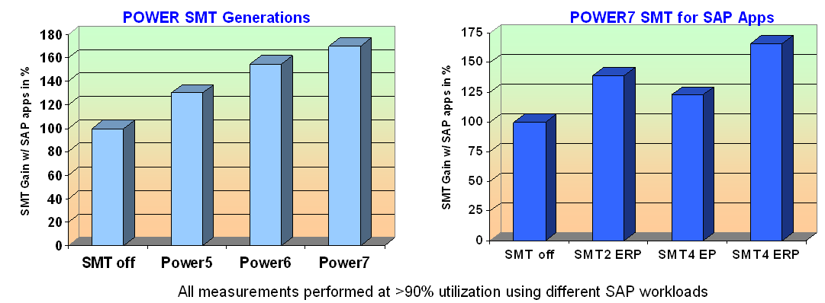
POWER7 based Servers and Application performance
By more Cores and more parallel Threads (SMT4), POWER7 based servers deliver excellent „SAPS“ values.
By nature of the benchmark SAPS are a good measure for system throughput.
Performance of an isolated user transaction or batch program is dominated by single thread performance. These do NOT benefit from SMT effect.
Whenever estimating single thread dominated SAP workload performance, avoid system sizing purely based on SAPS values.
In particular important when doing an upgrade sizing from existing POWER platforms with lower SMT gains (see left diagram):
Avoid running POWER7 systems in POWER6 Mode ➔ only SMT2 will be exploited.

Slide 6
POWER7 Multi-threading Options
SAP Dialog
Certain SAP workload characteristics benefit from different SMT modes
Always differentiate “system capacity” = SAPS and “performance” of a single thread = response time
SMT1: Largest unit of execution work
SMT2: Smaller unit of work, but provides greater amount of execution work per cycle
SMT4: Smallest unit of work, but provides the maximum amount of execution work per cycle
SAP Batch
Tx A
Tx A
Tx B
Aggregate throughput/ POWER7 core
Tx C
Sequential Job A
Single-threaded
Tx B
Tx D

Slide 7
POWER7 Virtual Processors & Entitlement (1)
Entitlements specify guaranteed CPU resources for a LPAR
Too low an entitlement means a partition’s portion of a dispatch cycle is small, and work may be spread across many dispatch cycles instead of fewer.
This artificially introduces relative hypervisor overhead compared to SAP workload
Cache hit ratio may be negatively impacted
Virtual Processors (vCPUs) specify the maximum of accessible CPU resources for a LPAR
Too many Virtual Processors being dispatched in a constrained environment reduces performance.
tests showed up to -30% performance impact for wrongly designed LPARs (entitlement / vCPU mismatch) running concurrent DB workloads, compared to best-practices LPAR setup
Processor Folding mitigates the overhead of spreading the partition over many more vCPUs, but does not completely eliminate it (-20% vs. -30%).
Is sub-optimal parameterization rather than PowerVM inefficiency
Spreading a LPAR over more vCPUs than needed increases the likelihood of lock contention during LPAR scheduling
Databases are particularly lock intensive, so conservative usage of vCPUs is beneficial

Slide 8
POWER7 Virtual Processors & Entitlement (2)
Entitlement settings should be realistic
Size LPAR entitlement in a way that it covers average high load phases
Ideal entitlement requires use of few incremental vCPUs only to cover absolute peak load
Peak loads > 100% of entitlement are not critical in shared processor pools
Adjust entitlement according to monitoring
Virtual Processor (vCPU) settings
Although it provides most flexibility in cross LPAR peak load compensation, avoid too large count of vCPUs beyond the cpu capacity allocated by a LPAR’s entitlement
If there are always free pool cycles, vCPU setting is less critical
Use (topas –C or lparstat “app”) to check
If the pool is constrained, however, the optimal performance will always be by keeping the vCPU to physical core ratio as close as possible
Read “POWER7 Virtualization Best Practice Guide” https://www.ibm.com/developerworks/wikis/display/WikiPtype/Performance+Monitoring+Documentation
Understand the differences in performance reporting across the POWER generations http://www.ibm.com/developerworks/wikis/display/WikiPtype/Understanding+Processor+Utilization+on+POWER+Systems+-+AIX

Slide 9
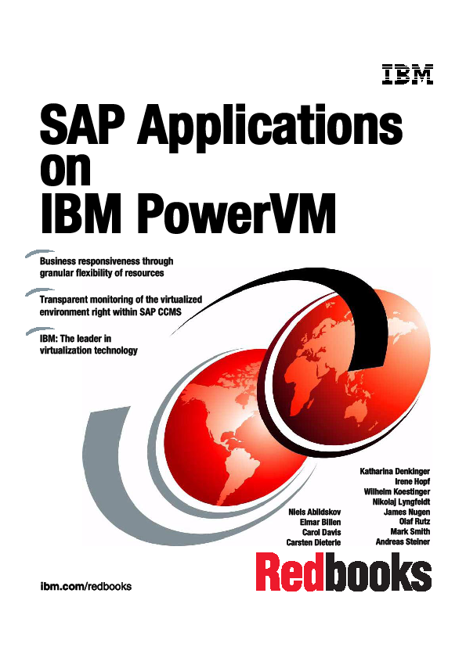
Helpful „SAP on IBM POWER“ documents
IBM internal competitive + reference materials available as a Cattail Collection:
http://cattail.boulder.ibm.com/cattail/#view=collections/C64753E05C0C3DDA93486644093F23B6
Comfortable Video-Demos available at TechDocs (includes PW & www):
POWER6 Live Partition Mobility Demo with SAP
http://w3.ibm.com/support/techdocs/atsmastr.nsf/WebIndex/PRS2921
Integration of IBM PowerVM and SAP Adaptive Computing Controller + CCMS
http://w3.ibm.com/support/techdocs/atsmastr.nsf/WebIndex/PRS4232
Whitepapers available
Live Migration of Power Partitions running SAP Applications (SAP SDN)
https://www.sdn.sap.com/irj/scn/go/portal/prtroot/docs/webcontent/uuid/b0b6911f-bf10-2c10-14ba-bc789953ff25
SAP Adaptive Computing Controller for IBM Power Systems and IBM System z
http://w3.ibm.com/support/techdocs/atsmastr.nsf/WebIndex/WP101745
Redbook completely reworked in October 2011
SAP Applications on PowerVM
http://www.redbooks.ibm.com/redbooks/pdfs/sg247564.pdf
ISICC Wiki Page covering SAP landscapes on IBM PowerVM
http://w3.tap.ibm.com/w3ki2/display/isicc/PowerVM+and+AIX+Virtualization

Slide 10
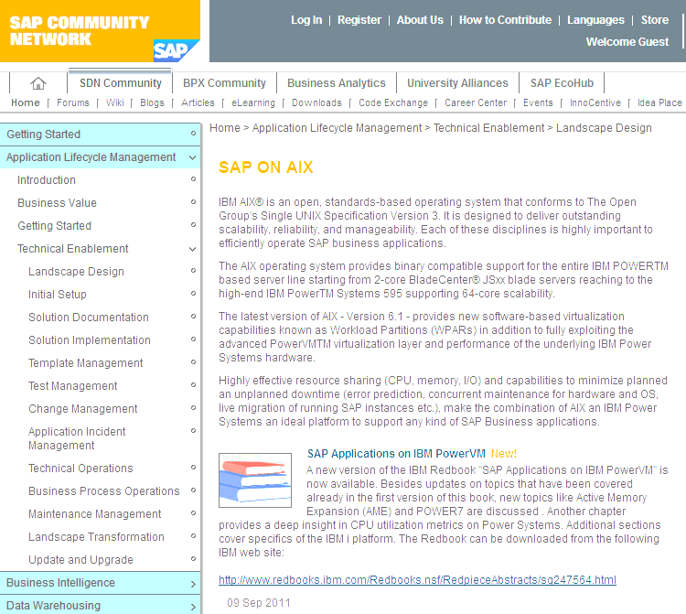
SAP Provided Information
Almost all technical SAP materials are maintend on the SAP Service Market Place. It requires a one time registration (S-User) in order to get access to the provided links and repositories at SAP.
Product Availability Matrix (PAM)
http://service.sap.com/pam
Lists all supported OS/DB/SAP stacks
Another technical Source is SAP Developer Network (SDN):
http://www.sdn.sap.com/irj/sdn
AIX Landing Page in SDN
http://www.sdn.sap.com/irj/sdn/aix
Public SAP Benchmark Entry Page
http://www.sap.com/solutions/benchmark/index.epx
2 tier is most common one and base for SAPS comparisons

Slide 11
SAP Notes about IBM POWER and AIX
PowerVM Virtualization
1002461 Support of IBM Dynamic LPAR and Micropartitioning
1102760 PowerVM Live Partition Mobility
1105456 SAP Installations in AIX 6.1 WPARs
1122387 Linux: SAP support in virtualized environments
1464605 POWER7 Active Memory Expansion
Monitoring
994025 Virtualized OS environments in the operating system monitor
113169 CPU utilization metrics of IBM System p
1379855 Include VIOS Partitions into SAP Performance Monitoring
SAP Applications on AIX
1087498 Support for AIX 6.1
1137862 Using SAP systems with AIX 6.1
1096445 AIX 6.1 known problems for validation
1048686 Recommended AIX settings for SAP
1458918 Support for AIX 7.1
1541935 Using SAP systems with AIX 7.1
973227 AIX Virtual Memory Management: Tuning Recommendations
789477 Large extended memory on AIX (64-bit) as of Kernel
1088458 AIX: Performance improvement for ES/SHM_SEGS_VERSION
856848 AIX Extended Memory Disclaiming
1121904 SAP on AIX: Recommendations for paging space
948294 AIX JFS2: mount options to use with Oracle 10g / 11g
1289460 ORA-354 on AIX5L if agblksize is not set correctly
For registered S-Users
can be accessed via
http://service.sap.com/notes

Slide 12
声明：
所有的版权属于原有公司，文件均来自公开渠道
此文件仅供学习使用，任何人不得进行以此为商业目的的行为
如有疑问，请立即删除
学习世界五百强和咨询公司PPT课程请访问如下网站搜索：“司马懿”
百度传课：司马懿PPT学校
网易学堂：司马懿PPT学校
知乎： 司马懿PPT学校
访问地址
https://www.chuanke.com
访问地址
https://study.163.com
访问地址
https://www.zhiu.com

